Slide 1


Using Machine Learning Methods to Automate an Academic Course Timetabling Process
Areeb Shafqat: WMG, University of Warwick

Slide 2
Session Structure
Introduction and Problem Statement
Related Approaches
Implementation and Results
Summary and Future Work

Slide 3
1.1 Problem Definition
Automation of the course/module timetabling process at a large academic department. These are a set of challenges the work will seek to address:
Rising student numbers (approx. 1,500 p.a.)
Lots of stakeholders and courses
Limited room resources (impact of COVID-19)
Unusual module delivery approach (1-week blocks)
NP-Hard optimisation problem
No single “optimal” solution
Using Machine Learning to Automate Course Timetabling: Slide 3

Slide 4

1.2 “To-Be” System
INPUT
Requirements/constraints: rooms; staff; modules; dates; sequencing; preferences
SYSTEM
Potential Timetables: A prioritised set of valid timetables that can be used
OUTPUT
Using Machine Learning to Automate Course Timetabling: Slide 4

Slide 5
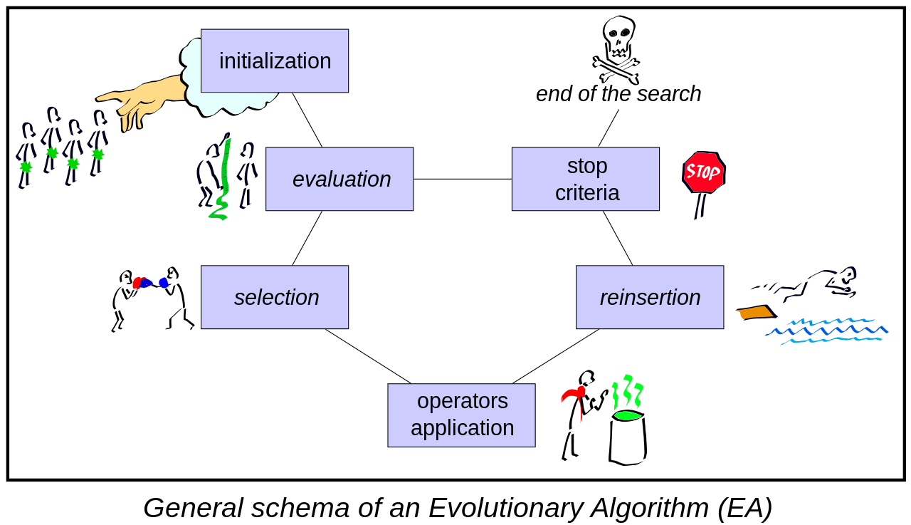
2.1 Evolutionary Algorithms (EAs)
Using Machine Learning to Automate Course Timetabling: Slide 5

Slide 6
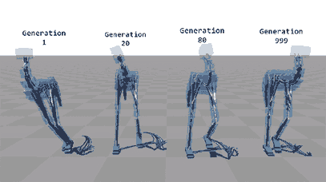
2.1 Evolutionary Algorithms (EAs)
EAs have been widely used for timetabling problems. However, there are limitations here:
Hard to implement (lots of hyperparameters)
Can get stuck in local optima (rather than global)
Low internal diversity (suits finding single solutions)
Using Machine Learning to Automate Course Timetabling: Slide 6

Slide 7
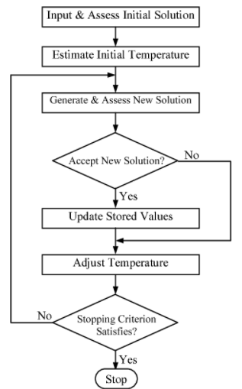
2.2 Simulated Hardening (SH)
A variant of Simulated Annealing (SA):
SH is implemented to maximize soft constraint satisfaction e.g., minimize module-free weeks for student groups.
The probability factor in SH increases when results are stable unlike SH.
Using Machine Learning to Automate Course Timetabling: Slide 7

Slide 8
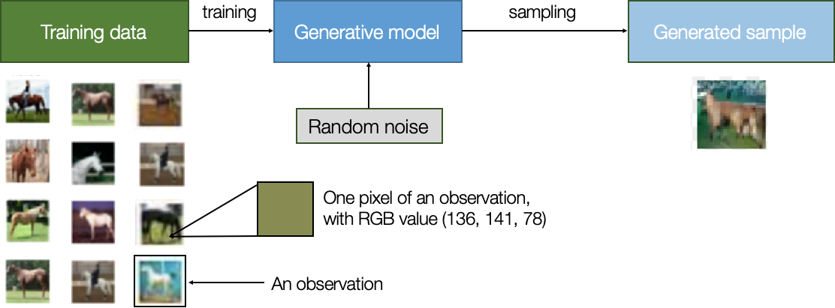
2.3 Generative Models
Using Machine Learning to Automate Course Timetabling: Slide 8

Slide 9
2.4 Generative Adversarial Network
The basic process idea of a GAN is as follows:
A generator model (artificial neural network – ANN) is created that takes random noise and learns to build valid data examples
A discriminator model (also an ANN) is created that is trained to recognise valid data (training data)
The discriminator is sent both real examples (from the training data) and fake (from the generator) and is tasked to classify each as real (1) or fake (0)
Using Machine Learning to Automate Course Timetabling: Slide 9

Slide 10
2.4 Generative Adversarial Network
The basic process idea of a GAN is as follows:
The discriminator is trained to optimise against loss (misclassification of real or generated data); the generator is trained to maximise the number of times its generated data is classified by the discriminator as real
Has been particular successful when used for image generation or image transformation (conditional-GANs)
Using Machine Learning to Automate Course Timetabling: Slide 10

Slide 11

2.4 Generative Adversarial Network
Using Machine Learning to Automate Course Timetabling: Slide 11

Slide 12
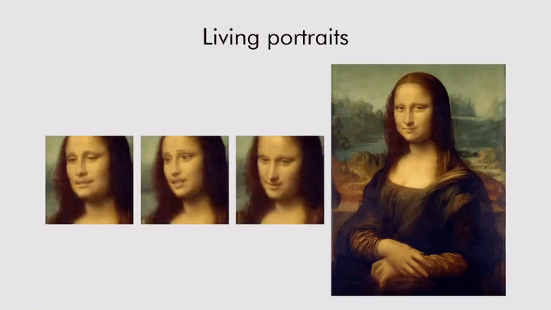
2.4 Generative Adversarial Network
GANs also have limitations in our case:
Expensive and difficult to train
Can only learn valid or invalid (not “optimal”)
Require training data (valid timetables)
Using Machine Learning to Automate Course Timetabling: Slide 12

Slide 13
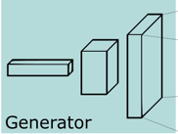
3.1 Proposed Solution
Using Machine Learning to Automate Course Timetabling: Slide 13

Slide 14
3.1 Proposed Solution
The basic premise is as follows:
We build a generator model (ANN) that is fed random noise which is in the shape of the input created in our EA implementation
The generator creates batches of artificial/fake data (timetables) and feeds to the discriminator
The discriminator is an EA + SH implementation that will optimise an initial solution (created by the generator)
Using Machine Learning to Automate Course Timetabling: Slide 14

Slide 15
3.1 Proposed Solution
The basic premise is as follows:
The discriminator has a set of metadata associated with the required solution (e.g. hard and soft constraints such as number of modules, etc.)
The discriminator will seek to create a valid result from this initial input (meets all hard constraints)
If the discriminator meets all constraints as met it will feedback to the generator a full success; if it meets none then a full failure….
Using Machine Learning to Automate Course Timetabling: Slide 15

Slide 16
3.2 Model Outputs
4x Hard Constraints
1/4 Met
2/4 Met
3/4 Met
4/4 Met
return 0.25
return 0.5
return 0.75
return 1.0
Using Machine Learning to Automate Course Timetabling: Slide 16

Slide 17
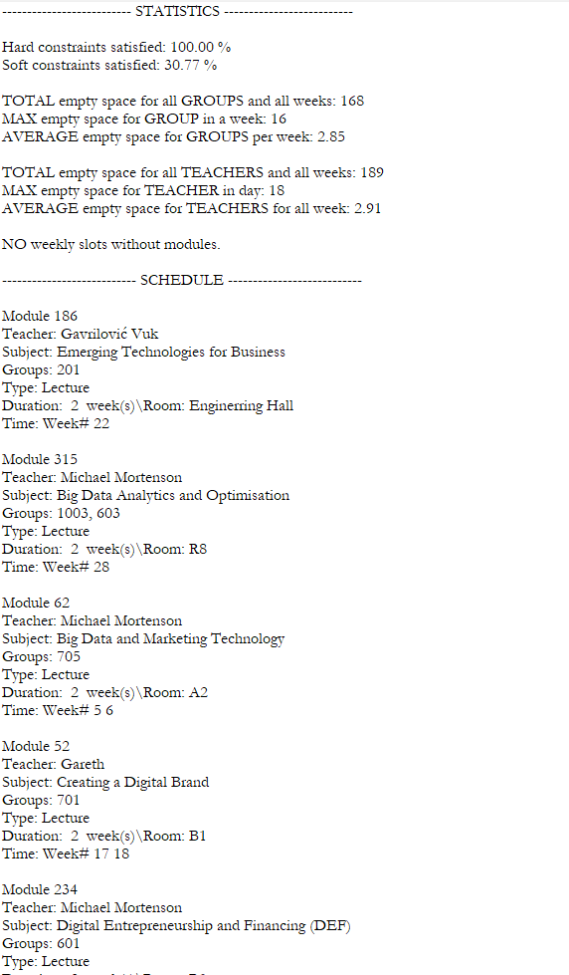
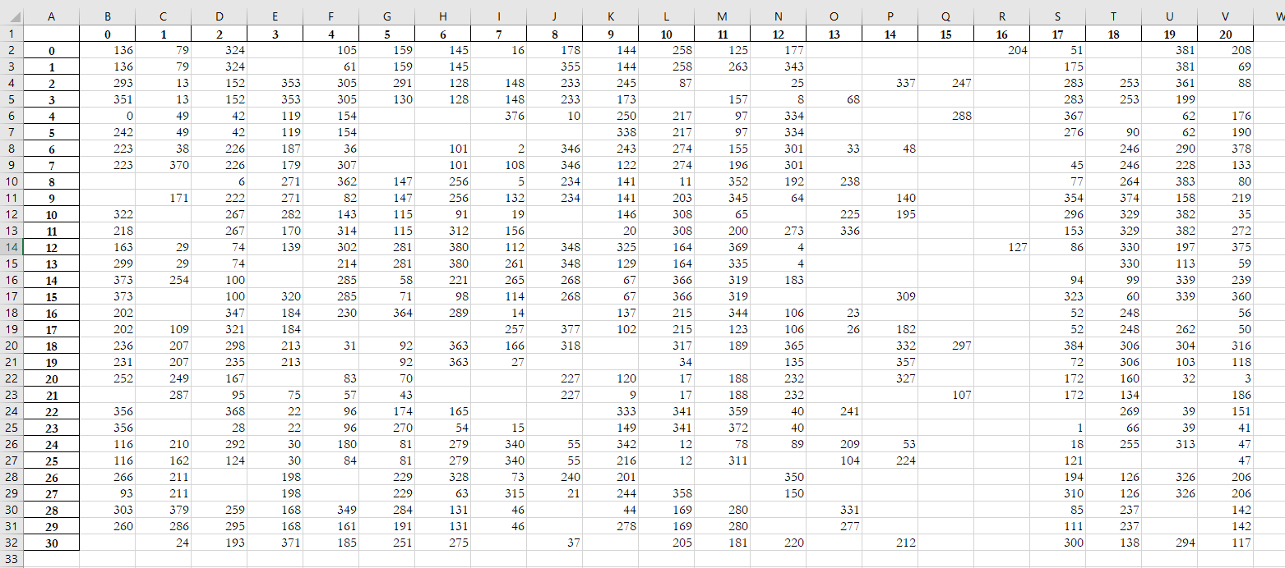
3.3 Implementation
Model generates a text and excel file:
Using Machine Learning to Automate Course Timetabling: Slide 17

Slide 18
4.1 Future Work
INPUT
Requirements/constraints: rooms; staff; modules; dates; sequencing; preferences
SYSTEM
Potential Timetables: A prioritised set of valid timetables that can be used
OUTPUT
Using Machine Learning to Automate Course Timetabling: Slide 18

Slide 19
4.2 Generalisation
As discussed, training for the generator is expensive (time and compute resource). In training it will only learn to fit the specific timetable brief for the given year, and cannot necessarily create valid timetables for another problem/year.
However, training via transfer learning is possible/recommended …
Using Machine Learning to Automate Course Timetabling: Slide 19

Slide 20
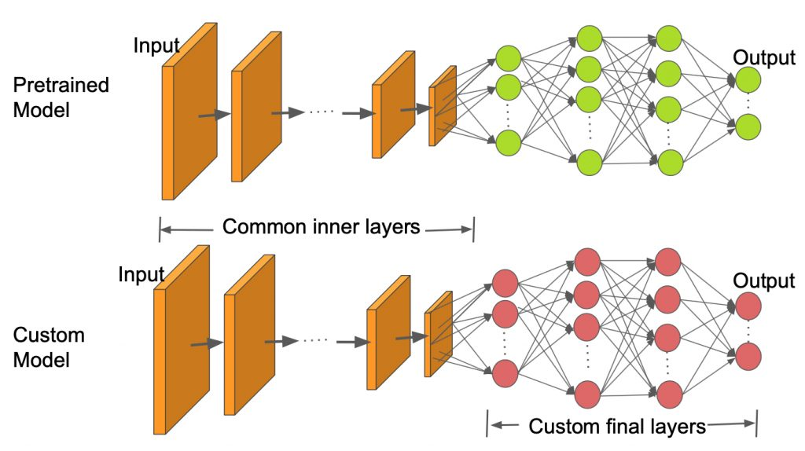
4.3 Transfer Learning
Using Machine Learning to Automate Course Timetabling: Slide 20

Slide 21
4. Summary
In summary:
We present a hybrid GAN / EA model – with an ANN generator and EA/SH discriminator – that can generate multiple valid timetables
The model can be updated each year by changing configuration parameters and retraining just the final layer of the model
Other applications of the approach may be found in non-academic timetabling, logistics (Flow-shop scheduling) and other related domains
Using Machine Learning to Automate Course Timetabling: Slide 21

Slide 22

Using Machine Learning to Automate Course Timetabling: Slide 22

